Slide 1
TestLab – ProfiNet Network Tester
Tomáš Davidovič
13. 9. 2006

Slide 2

Motivation
Introduction
TestLab -> tempLab
tempLab –testing devices for ProfiNet network
ProfiNet – open Industrial Ethernet standard
Industrial Network – lot of noise on wires
tempLab – NetBreaking – noise simulation
Measures temperature in the tested devices

Slide 3
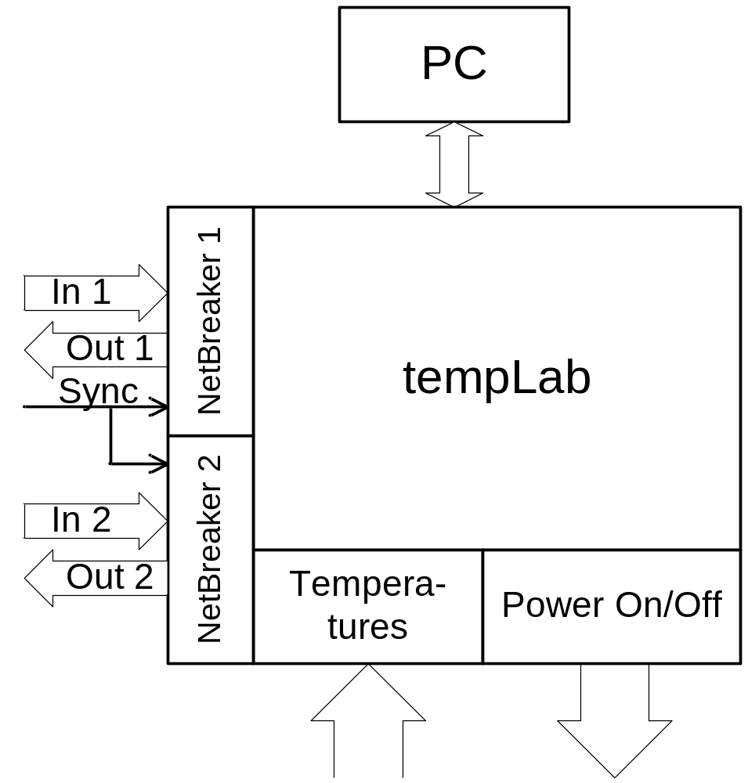
Scheme of tempLab
Introduction

Slide 4
Technical requirements
Introduction
Precise noise generation (NetBreaker)
  Two network branch switches
  Two switches breaking RX a TX wires separately
  Parallel function of all four switches
  30ns precision
  Possibility of external synchronization
  Generation of noise sequencies
Controlling and monitoring of devices
  Up to sixteen devices
  Turning the devices on and off
  Measure temperature in the devices

Slide 5

NetBreaker – Basic principle
Introduction
Branch switching
RX and TX breaking
RX
RX
TX
TX
NetBreaker
SWA (SWB)
NetBreaker
RX
NetBreaker
TX
NetBreaker
SWA
NetBreaker
SWB

Slide 6
tempLab – Decomposition
Decomposition
tempLab
PC
Net-
Breaker
MFC
Control
panel
COM
DLL
Relays
CPLD
AVR
USB
Python
test
script
MAXII
EPM1270
AT43USB355
COM
DLL
Therm.
probes

Slide 7
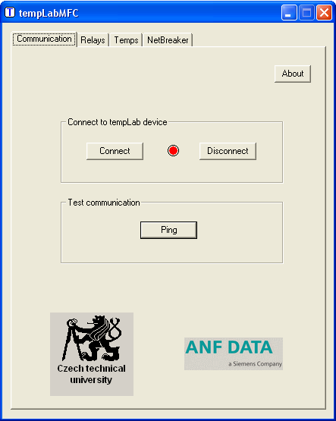
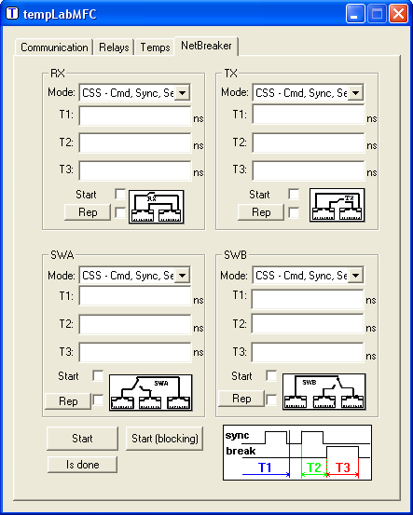
MFC GUI examples
Decomposition
Communication
NetBreakers

Slide 8
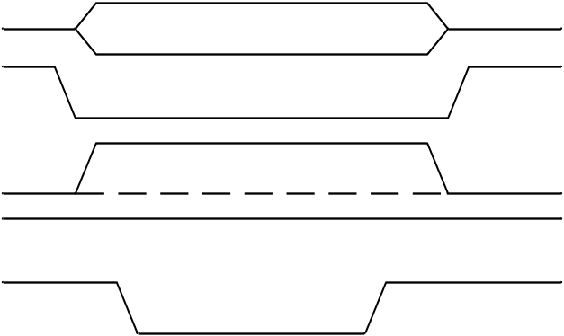
AVR<–>CPLD communication
CPLD
CPLD
DATA
AVR
CS
RD
WR
ALE
Communication – functions mapped to addresses
Address/data writing
Read relay state and write a new one:
writeAddr(0x50) //relay address
oldState = readData()
writeData(newState)
DATA
CS
ALE
(address)
RD
WR

Slide 9
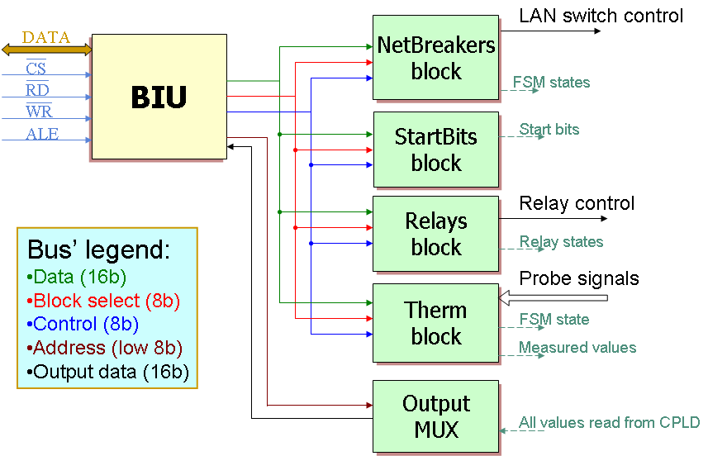
tempLab – CPLD structure
CPLD

Slide 10
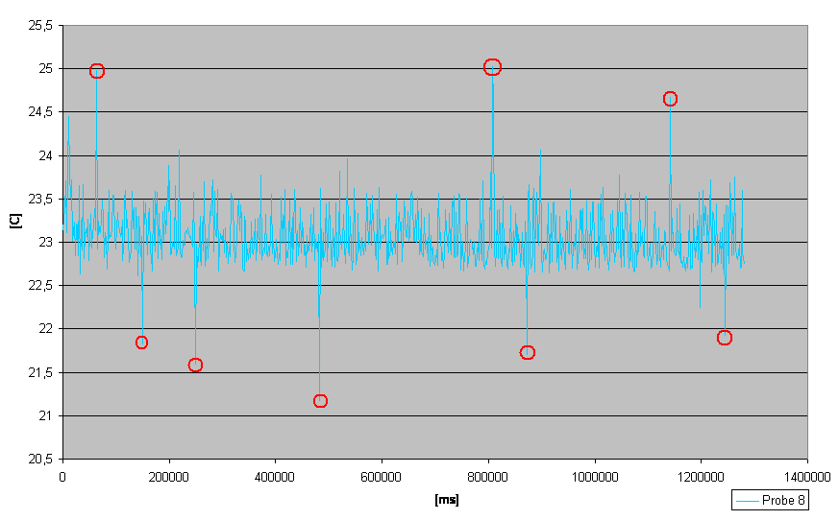
Testing – thermometer error
Testing

Slide 11
Wrap Up
Wrap Up
Current state of tempLab
  Fulfills all set requirements
  Passed through lab tests
  Field tests almost finished
Future work
  Protocol can support new functions
  CPLD is “full” (95% LEs, 100% LABs)
  Drop old functions or redo the hardware
  COM DLL – more support for parallel access to tempLab

Slide 12
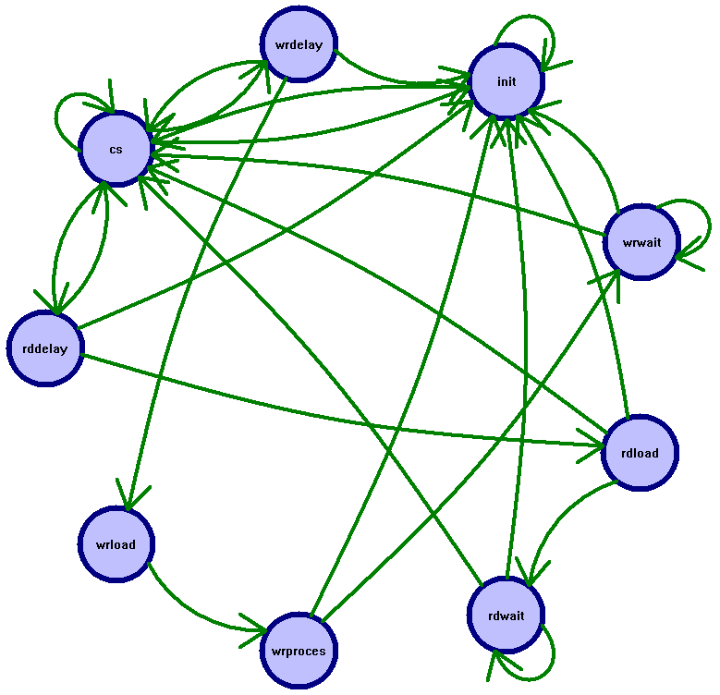
BIU – FSM diagram
Wrap Up

Slide 13
BIU – FSM State transition table
Wrap Up
 | Next state |  |  |  |  | Outputs
 | CSnxSI RDnxSI WRnxSI
States | 000 | 001 | 010 | 011 | 1XX | ReadxSO | WritexSO | ProcessxSO
Init | CS | CS | CS | CS | Init | 0 | 0 | 0
CS | CS | WRDelay | RDDelay | CS | Init | 0 | 0 | 0
RDDelay | RDLoad | RDLoad | CS | CS | Init | 0 | 0 | 0
RDLoad | RDWait | RDWait | CS | CS | Init | 1 | 0 | 0
RDWait | RDWait | RDWait | CS | CS | Init | 0 | 0 | 0
WRDelay | WRLoad | CS | WRLoad | CS | Init | 0 | 0 | 0
WRLoad | WRProcess | WRProcess | WRProcess | WRProcess | Init | 0 | 1 | 0
WRProcess | WRWait | CS | WRWait | CS | Init | 0 | 0 | 1
WRWait | WRWait | CS | WRWait | CS | Init | 0 | 0 | 0

